Slide 1


Beyond Pass Completion: Automating the Detection of Line-Breaking Passes
in Association Football
Vladislav Manolov

Slide 2
TABLE OF CONTENTS
1
2
3
4
Data & Data Pre-Processing
Feature Engineering & Methodology
Classification & Analysis
Detection of Line-Breaking Passes

Slide 3
Pep Guardiola
“You have to pass the ball with a clear intention, with the aim of making it into the opposition’s goal.”

Slide 4
Project Scope
Aim: Automatic Classification of line-breaking passes in football through combination of event and tracking data

Slide 5
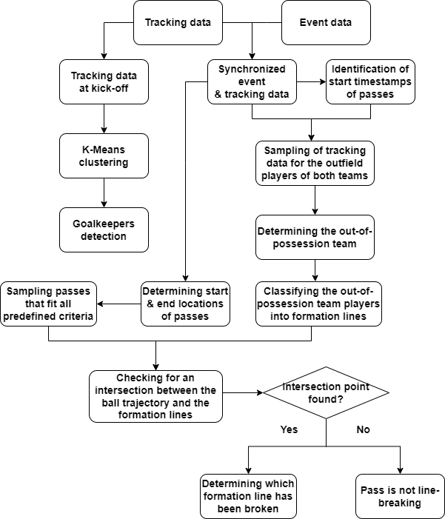
Procedural Pipeline

Slide 6
1
Data & Data Pre-Processing

Slide 7
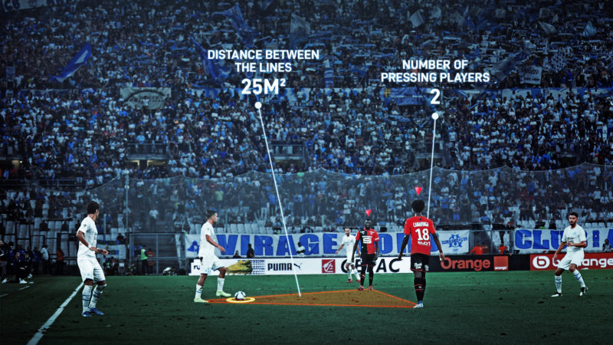

Tracking & Event Data
Merged event & tracking data on event ID
Start location of a pass: the location of the ball at the given frame
End location of a pass: the start location of a ball receipt event

Slide 8

Goalkeeper Exclusion
For each game the goalkeepers are identified at the start of the game and excluded from the clustering pipeline

Slide 9
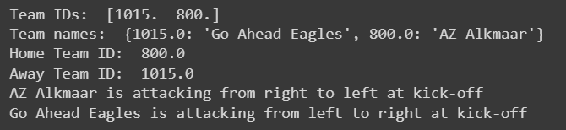
Identifying Home & Away Teams at kick-off
Retrieving the IDs and names of the teams taking part in the game
Retrieving the mean kick-off positions for both teams
Determining which side each team is attacking from at kick-off
Benefit: classifying only the players of the defending team into formation lines irrespective of the team in control of the ball or the match half

Slide 10
2
Feature Engineering
&
Methodology

Slide 11
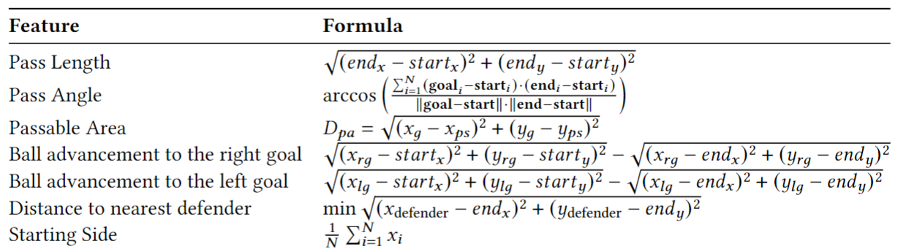
Hand-crafted features

Slide 12
Supplementary Functions
Pass Angle
Half-Time Duration
Player Data
Calculating the pass angle
Calculating the elapsed time during the half-time break
Retrieving the most relevant data about individual players

Slide 13
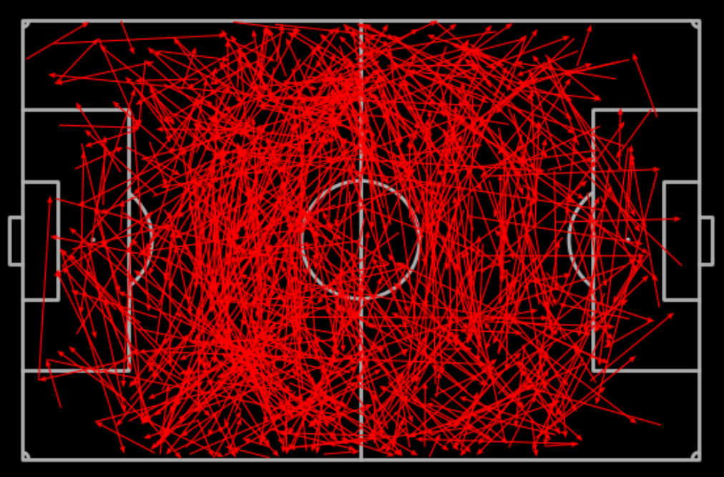
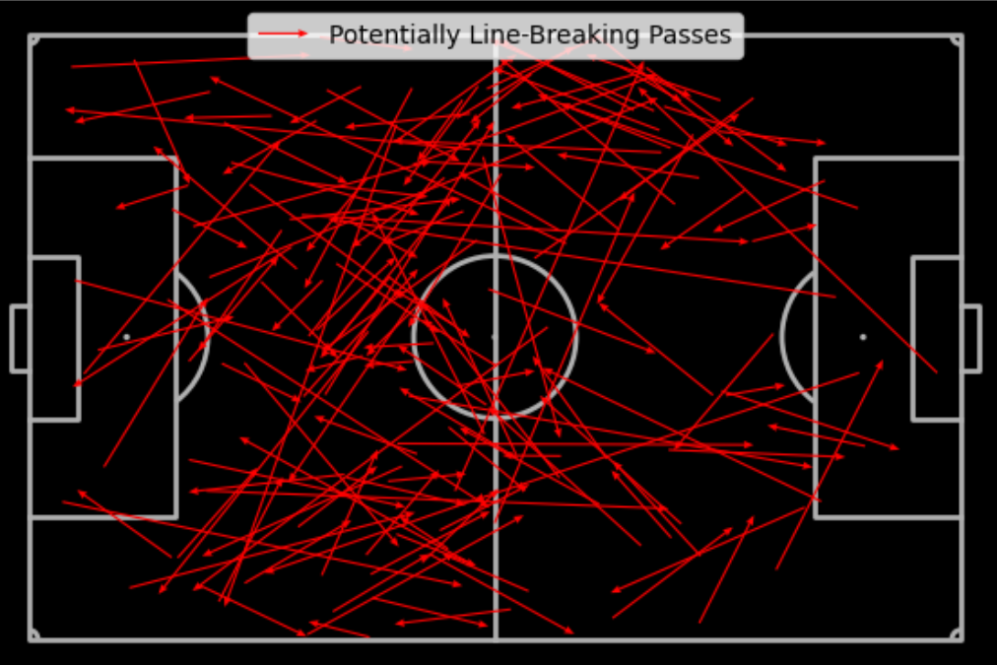
Potentially Line-Breaking Passes
All Successful Open-Play Passes
Potentially Line-Breaking Passes

Slide 14
3
Detection of Line-Breaking Passes

Slide 15
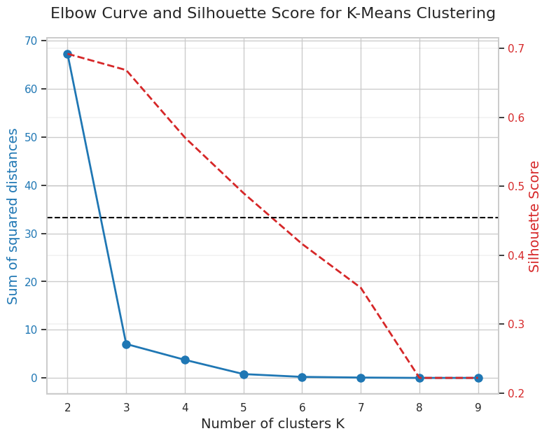
Optimal Number of Clusters
Chosen unsupervised approach: Constrained K-Means clustering
Justification:
Better time complexity
Better results
Other experimental approaches:
Hierarchical agglomerative clustering
DBSCAN
HDBSCAN

Slide 16
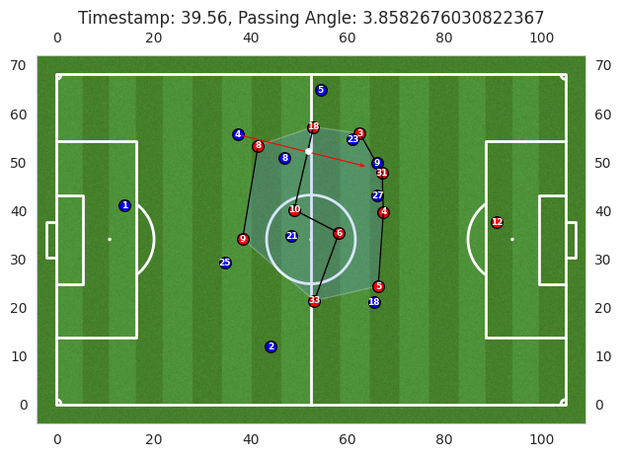
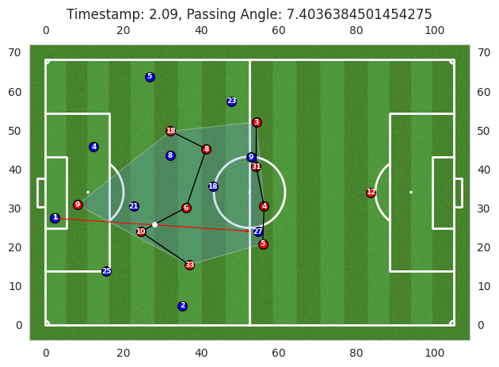
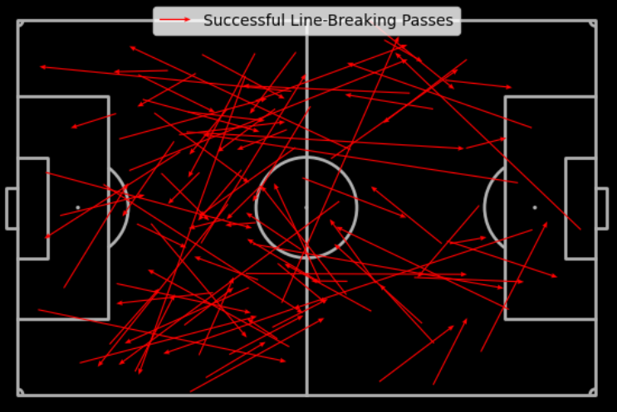
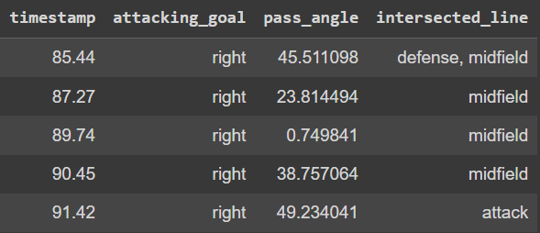
Line-Breaking
Passes

Slide 17
Comparison with StatsPerform & StatsBomb
StatsBomb:
StatsPerform:
Line-breaking passes: “completed passes that advance the ball at least 10% closer to the opposition goal and that intersect a pair of defenders in close proximity (x-axis) or pass behind the defensive line (y-axis)”.
Problems: too many passes down the flanks/ through balls are identified as line-breaking, although they don’t necessarily intersect a formation line
Line-breaking passes: “passes that intersect at least one opposition line and such that: progresses the ball forward at least 10 metres, have a starting point which is at least five metres away from the point of intersection, have an ending point of at least two metres beyond the deepest sitting player in the line.”
Problems: hard-coded values (particularly pass length is set to at least 10 meters)

Slide 18
4
Classification & Analysis

Slide 19
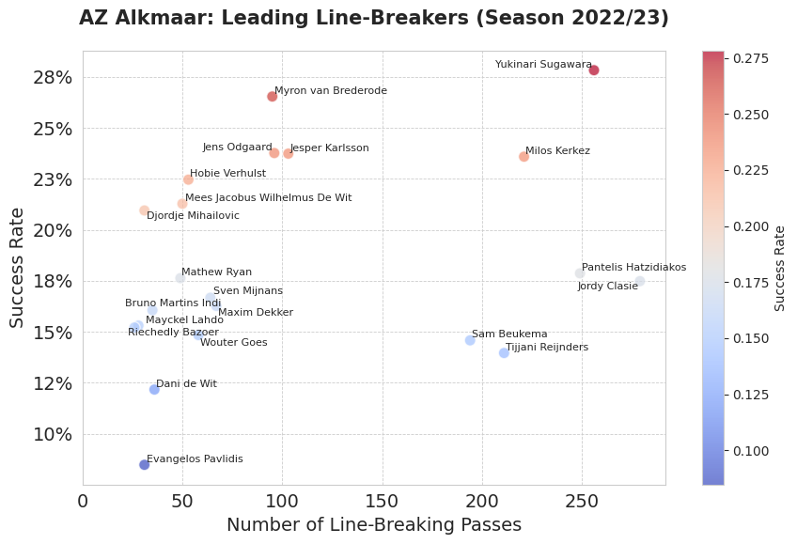
Leading Line-Breakers

Slide 20
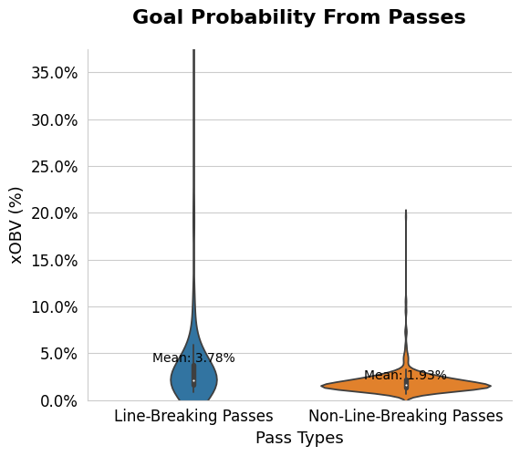
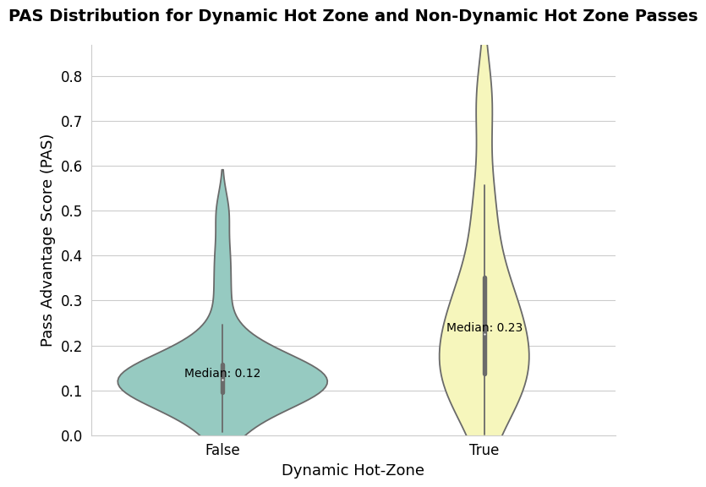
Analysis of Passes & Dynamic Hot-Zone
The Pass Advantage Score (PAS) metric is calculated based
on the zone in which a pass is received (dynamic hot-zone) and the proximity of the ball receiver to the nearest defender.

Slide 21
THANK YOU!

